Slide 1
GRADE 7 ACCELERATED · UNIT 2 · LESSON 6
Plotting, Ordering and Comparing Real Numbers
MA.8.NSO.1.2
I can compare, order and plot every kind of real number in this unit.
Nothing new today.
This is the rehearsal. The assessment is next.
Grade 7 Accelerated · Unit 2 · Lesson 6 — Plotting, Ordering and Comparing Real Numbers
1

Slide 2
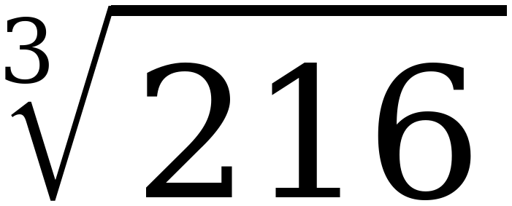
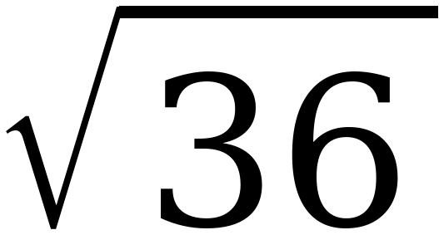
Warm-Up
On your own. Four minutes.
Same and different
What is the same about these two, and what is different?
Grade 7 Accelerated · Unit 2 · Lesson 6 — Plotting, Ordering and Comparing Real Numbers
2

Slide 3
Review
I. Is it rational? Check the radicand, not the radical
A.
Rational: any ratio of two integers — every fraction, every whole number, every decimal that stops or repeats.
B.
√ of a perfect square and ∛ of a perfect cube are rational. They are integers.
C.
Anything else under a √ or a ∛ is irrational. So is π, and π times any NON-ZERO fraction.
Grade 7 Accelerated · Unit 2 · Lesson 6 — Plotting, Ordering and Comparing Real Numbers
3

Slide 4
Review
II. Convert first. Then order by position
A.
Convert every number to a decimal, and write the decimals down.
B.
Exact where you can. Nearest tenth where you cannot.
C.
Then order by position: further left is less, further right is greater. Always.
D.
Watch the negatives. −7 is LESS than −6.28.
Grade 7 Accelerated · Unit 2 · Lesson 6 — Plotting, Ordering and Comparing Real Numbers
4

Slide 5
Review
III. Plot: integers first, then the tenth
A.
Check the tick points before you start. They are not always worth 1.
B.
Find the two integers it sits between, put a light mark between them, then slide the point to the tenth.
C.
Label every point. An unlabeled dot earns nothing.
D.
If two points are close together, put one label above the line and one below.
Grade 7 Accelerated · Unit 2 · Lesson 6 — Plotting, Ordering and Comparing Real Numbers
5

Slide 6
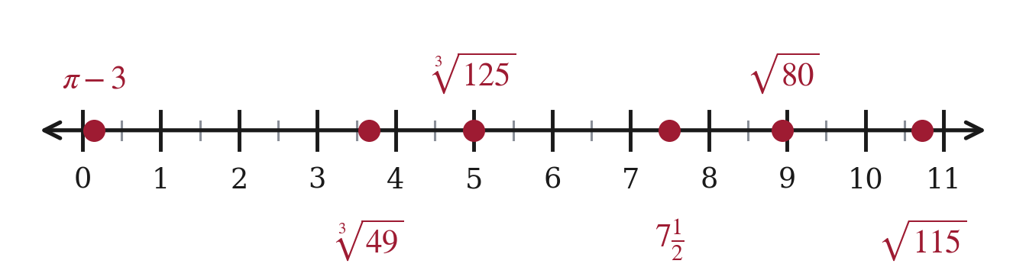
Review
Six points on one line — question 11 of the circuit.
III. Plot: integers first, then the tenth
Grade 7 Accelerated · Unit 2 · Lesson 6 — Plotting, Ordering and Comparing Real Numbers
6

Slide 7
Example 1
Four comparisons. One of them is an equality.
Left
Right
Decimals
−5π
−√225
∛125
√100 ÷ 2
−7
−∛49
29/3
√80
Grade 7 Accelerated · Unit 2 · Lesson 6 — Plotting, Ordering and Comparing Real Numbers
7

Slide 8
Example 1
The decimals.
Left
Right
Decimals
−5π
−√225
−15.71 and −15
∛125
√100 ÷ 2
5 and 5
−7
−∛49
−7 and −3.66
29/3
√80
9.67 and 8.94
Grade 7 Accelerated · Unit 2 · Lesson 6 — Plotting, Ordering and Comparing Real Numbers
8

Slide 9
Example 1
The symbols.
Left
Right
Decimals
−5π
<
−√225
−15.71 and −15
∛125
=
√100 ÷ 2
5 and 5
−7
<
−∛49
−7 and −3.66
29/3
>
√80
9.67 and 8.94
Grade 7 Accelerated · Unit 2 · Lesson 6 — Plotting, Ordering and Comparing Real Numbers
9

Slide 10
Example 2
Rational or irrational? Work each radical out first.
10.2
11⅓
∛64 + 8
−π + 16
√190
Grade 7 Accelerated · Unit 2 · Lesson 6 — Plotting, Ordering and Comparing Real Numbers
10

Slide 11
Example 2
Sorted, and their decimals.
10.2
11⅓
∛64 + 8
−π + 16
√190
rational
rational
rational
irrational
irrational
10.2
11.33
12
12.86
13.78
Grade 7 Accelerated · Unit 2 · Lesson 6 — Plotting, Ordering and Comparing Real Numbers
11

Slide 12
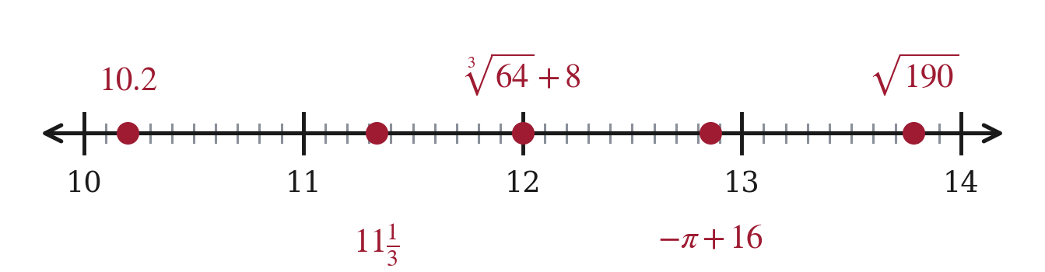
Example 2
Plotted.
Grade 7 Accelerated · Unit 2 · Lesson 6 — Plotting, Ordering and Comparing Real Numbers
12

Slide 13
Example 3
Sara's reasoning. Read it carefully.
“11 is between 9 and 16, which are both perfect squares.
So ∛11 lies between 3 and 4, and it is closer to 3.”
What is RIGHT about what she did?
Grade 7 Accelerated · Unit 2 · Lesson 6 — Plotting, Ordering and Comparing Real Numbers
13

Slide 14
Example 3
And what is wrong.
What Sara did
What she should have done
9 < 11 < 16 perfect SQUARES
8 < 11 < 27 perfect CUBES
between 3 and 4
between 2 and 3
Grade 7 Accelerated · Unit 2 · Lesson 6 — Plotting, Ordering and Comparing Real Numbers
14

Slide 15
Example 3
What it costs.
Sara's answer
The right answer
∛11 ≈ 3.3
∛11 ≈ 2.2
Grade 7 Accelerated · Unit 2 · Lesson 6 — Plotting, Ordering and Comparing Real Numbers
15

Slide 16
Whiteboards · Question 1 of 9
Boards up on three.
6
Compare the two numbers.
Write <, > or =.
Grade 7 Accelerated · Unit 2 · Lesson 6 — Plotting, Ordering and Comparing Real Numbers
16

Slide 17
Whiteboards · Question 1 of 9
Answer.
6
6.00 and 6.00
Answer: =
Grade 7 Accelerated · Unit 2 · Lesson 6 — Plotting, Ordering and Comparing Real Numbers
17

Slide 18
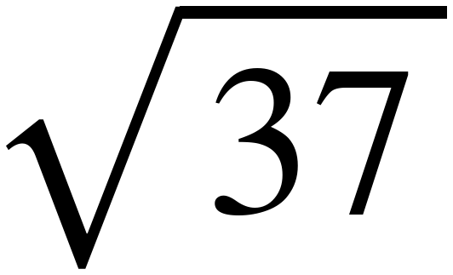
Whiteboards · Question 2 of 9
Boards up on three.
6
Compare the two numbers.
Write <, > or =.
Grade 7 Accelerated · Unit 2 · Lesson 6 — Plotting, Ordering and Comparing Real Numbers
18

Slide 19
Whiteboards · Question 2 of 9
Answer.
6
6.08 and 6.00
Answer: >
Grade 7 Accelerated · Unit 2 · Lesson 6 — Plotting, Ordering and Comparing Real Numbers
19

Slide 20
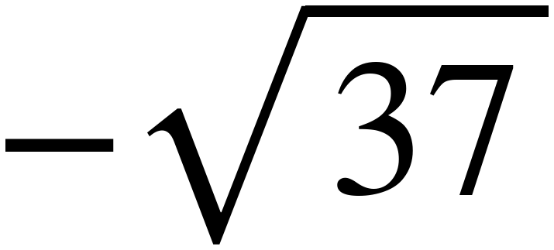
Whiteboards · Question 3 of 9
Boards up on three.
−6
Compare the two numbers.
Write <, > or =.
Grade 7 Accelerated · Unit 2 · Lesson 6 — Plotting, Ordering and Comparing Real Numbers
20

Slide 21
Whiteboards · Question 3 of 9
Answer.
−6
−6.08 and −6.00
Answer: <
Grade 7 Accelerated · Unit 2 · Lesson 6 — Plotting, Ordering and Comparing Real Numbers
21

Slide 22
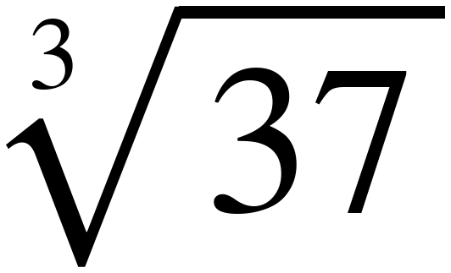
Whiteboards · Question 4 of 9
Boards up on three.
6
Compare the two numbers.
Write <, > or =.
Grade 7 Accelerated · Unit 2 · Lesson 6 — Plotting, Ordering and Comparing Real Numbers
22

Slide 23
Whiteboards · Question 4 of 9
Answer.
6
3.33 and 6.00
Answer: <
Grade 7 Accelerated · Unit 2 · Lesson 6 — Plotting, Ordering and Comparing Real Numbers
23

Slide 24
Whiteboards · Question 5 of 9
Boards up on three.
6
Compare the two numbers.
Write <, > or =.
Grade 7 Accelerated · Unit 2 · Lesson 6 — Plotting, Ordering and Comparing Real Numbers
24

Slide 25
Whiteboards · Question 5 of 9
Answer.
6
6.00 and 6.00
Answer: =
Grade 7 Accelerated · Unit 2 · Lesson 6 — Plotting, Ordering and Comparing Real Numbers
25

Slide 26
Whiteboards · Question 6 of 9
Boards up on three.
Compare the two numbers.
Write <, > or =.
Grade 7 Accelerated · Unit 2 · Lesson 6 — Plotting, Ordering and Comparing Real Numbers
26

Slide 27
Whiteboards · Question 6 of 9
Answer.
6.00 and 6.00
Answer: =
Grade 7 Accelerated · Unit 2 · Lesson 6 — Plotting, Ordering and Comparing Real Numbers
27

Slide 28
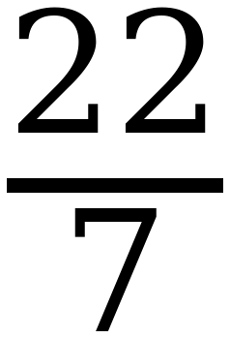

Whiteboards · Question 7 of 9
Boards up on three.
Compare the two numbers.
Write <, > or =.
Grade 7 Accelerated · Unit 2 · Lesson 6 — Plotting, Ordering and Comparing Real Numbers
28

Slide 29
Whiteboards · Question 7 of 9
Answer.
3.142857… and 3.141592…
Answer: >
Grade 7 Accelerated · Unit 2 · Lesson 6 — Plotting, Ordering and Comparing Real Numbers
29

Slide 30
Whiteboards · Question 8 of 9
Boards up on three.
Compare the two numbers.
Write <, > or =.
Grade 7 Accelerated · Unit 2 · Lesson 6 — Plotting, Ordering and Comparing Real Numbers
30

Slide 31
Whiteboards · Question 8 of 9
Answer.
6.00 and 3.14
Answer: >
Grade 7 Accelerated · Unit 2 · Lesson 6 — Plotting, Ordering and Comparing Real Numbers
31

Slide 32
Whiteboards · Question 9 of 9
Take your time. Boards up when you have written it.
Put these in order, least to greatest: −√37 ∛37 6 √37
Write your answer in sentences.
This one is written work. Say how you decided.
Grade 7 Accelerated · Unit 2 · Lesson 6 — Plotting, Ordering and Comparing Real Numbers
32

Slide 33
Whiteboards · Question 9 of 9
Answer.
Put these in order, least to greatest: −√37 ∛37 6 √37
−6.08 < 3.33 < 6.00 < 6.08
Answer: −√37, ∛37, 6, √37
Grade 7 Accelerated · Unit 2 · Lesson 6 — Plotting, Ordering and Comparing Real Numbers
33

Slide 34
IXL
Last five minutes.
1.
Open IXL and start today's skills.
2.
Work on paper where the question needs work. The answer box does not show it.
3.
Whatever you do not finish is tonight's practice.
4.
The skills for today are posted in Google Classroom.
Grade 7 Accelerated · Unit 2 · Lesson 6 — Plotting, Ordering and Comparing Real Numbers
34

